Slide 1
1. Problem Space
An eCommerce company based in Brazil is looking for partner to work on a data science and machine learning project. The company is one of the leading companies in Brazil, and sell a wide-range of products. In the moment they are particularly interested in boosting their online sales along with online reputation.
As part of this, they want you to build a prediction model that will help predict the customer review score, which will allow them to particularly target the customers who are more likely to leave good reviews with emails and targeted messages and therefore, get more good reviews.
DSML – Group Exercise: Slide 1

Slide 2
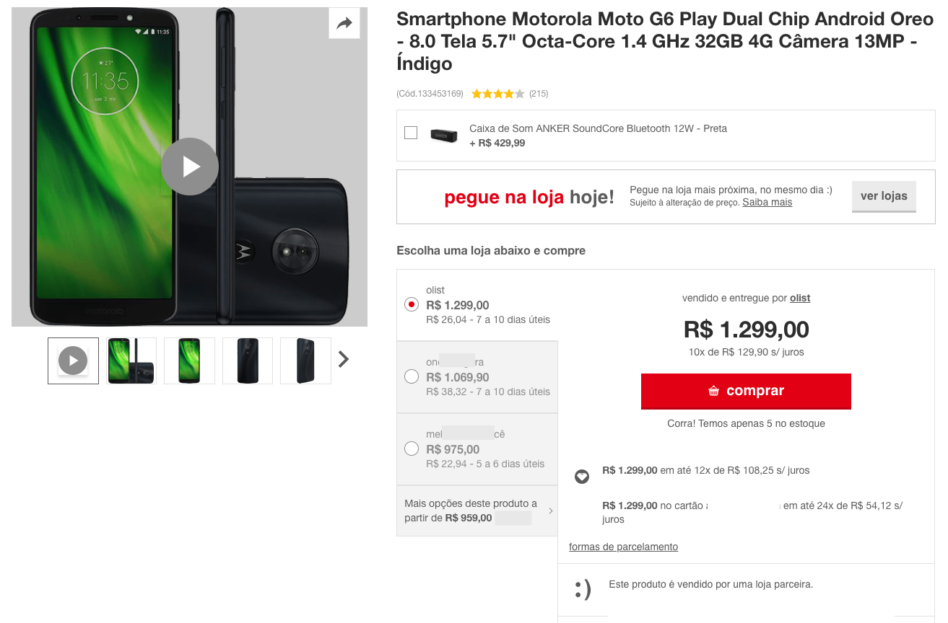
1. Problem Space
DSML – Group Exercise: Slide 2

Slide 3

2. Data
DSML – Group Exercise: Slide 3

Slide 4
2. Data
olist_order_reviews_dataset
review_id: Unique review ID (primary key)
order_id: Unique order ID (foreign key)
review_score: 1-5* (target)
review_comment_message: Any comments left by the customer (in Portugeese)
review_creation_date: The date the survey (email notification) was sent to the customer
review_answer_timestamp: When the customer completed the review
DSML – Group Exercise: Slide 4

Slide 5
2. Data
olist_customers_dataset
customer_id: Unique ID related to the order. Each new order generates a unique customer ID even if this customer has bought from the store before (foreign key)
customer_unique_id: Unique ID (one per customer) linked to their profile and order history (primary key)
customer_zip_code_prefix: First five characters of their zip code (post code)
customer_city: The name of the city the customer lives in (Brazilian)
customer_state: The state which the customer lives in (Brazilian)
DSML – Group Exercise: Slide 5

Slide 6
2. Data
olist_geolocation_dataset
geolocation_zip_code_prefix: The first five digits of the zip code (primary key)
geolocation_lat: Latitude
geolocation_lng: Longitude
geolocation_city: The name of the city the customer lives in (Brazilian)
geolocation_state: The state which the customer lives in (Brazilian)
DSML – Group Exercise: Slide 6

Slide 7
2. Data
olist_order_items_dataset
order_id: Unique ID of the order (foreign key)
order_item_id: Each item purchased in the same order (primary key)
product_id: The unique ID of each product purchased (foreign key)
seller_id: The unique ID of the seller (foreign key)
shipping_limit_date: The date the seller will send the order to the logistic partner
price: Item price
freight_value: The item freight value (if an order has multiple items the freight value is split between them)
DSML – Group Exercise: Slide 7

Slide 8
2. Data
olist_payments_dataset
order_id: Unique ID of the order (foreign key)
payments_sequential: A customer may pay with more than one method. This is the sequence of payments.
payment_type: Method of payment
payment_installments: If the payment is in instalments (multiple payments over time) this is the number of installments.
payment_value: Transaction value
DSML – Group Exercise: Slide 8

Slide 9
2. Data
olist_order_dataset
order_id: Unique ID of the order (primary key)
customer_id: An ID unique to each order. This provides access to the unique customer ID in the customer dataset
order_status: Delivered, shipped, etc.
order_purchase_timestamp: The time of the purchase.
order_approved_at: The time the payment was authorised
order_delivered_carrier_date: When the order was posted
order_estimated_delivery_date: Show the date the customer was advised that the order would be delivered at the time of purchase
DSML – Group Exercise: Slide 9

Slide 10
2. Data
olist_product_dataset
product_id: Unique ID of the product (primary key)
product_category_name: Name of the product category
product_name_lenght: Number of characters extracted from the product name
product_description_lenght: Number of characters extracted from the product description
product_photos_qty: Number of product photos online
product_weight_g: Product weight in grams
product_length_cm: Product length in centimetres
product_width_cm: Product width in centimetres
DSML – Group Exercise: Slide 10

Slide 11
2. Data
olist_sellers_dataset
seller_id: Unique ID of the seller (primary key)
seller_zip_code_prefix: The first five digits of the seller’s zip code (post code)
seller_city: City where the seller is based
seller_state: State where the seller is based
DSML – Group Exercise: Slide 11

Slide 12
2. Data
olist_sellers_dataset
product_category_name: Product category name in Portuguese
product_category_name_english: Product category name in English
WARNINGS!!!!!
An order may have multiple items
Each item may be fulfilled by different sellers
All text identifying stores and partners have been replaced with Game of Thrones great houses
DSML – Group Exercise: Slide 12

Slide 13
3. Task
The business wants to have more reviews on their website, but they particularly want good reviews! They want to be able to target customers who otherwise would not write a review with an email and special offer prompting them to do so. However, they want this to be targeted at the “right” kind of customers.
You will need to build one models that can predict the customer review score (1-5*). You can treat it as either binary task, multi-classification or regression task. But remember your client want more good reviews.
Although not much cleaning is required, you will need to merge some datasets. Also think hard about the features you want to include and any aggregation or transformations you want to perform.
DSML – Group Exercise: Slide 13

